Slide 1


Introduction to Science and Research
DEPH 312 Principles of Scientific Evidence
Talal Alshihayb ^{BDS, DScD}
Diplomate, American Board of Dental Public Health
Assistant Professor
Department of Preventive Dental Science, College of Dentistry, King Saud bin Abdulaziz University for Health Sciences
Department of Health Policy and Health Services Research, Henry M. Goldman School of Dental Medicine, Boston University
November 30, 2023
shihaybt@ksau-hs.edu.sa

Slide 2

LECTURE LEARNING OUTCOMES OF EACH OF THE DIDACTIC SESSIONS
REFERENCE:
P. 29-32 of chapter 3 in Epidemiology an Introduction by Kenneth Rothman
Chapter 1 in McElreath R. Statistical rethinking: A Bayesian course with examples in R and Stan. CRC press; 2020 Mar 13
Chapters 1 and 2 in The effect: An Introduction to Research Design and Causality by Nick Huntington-Klein https://theeffectbook.net/
Chapter 2 in Aday LA, Cornelius LJ. Designing and conducting health surveys: a comprehensive guide. John Wiley & Sons; 2006 Apr 14
LECTURE LEARNING OUTCOMES:
Define the meaning of science.
Outline the importance of research.
Outline the different hypotheses.

Slide 3
How do you think we learn about the world?

Slide 4
How do you think science works?

Slide 5
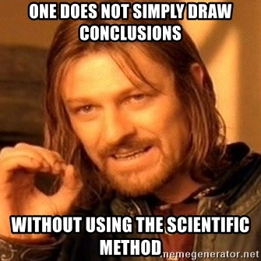
https://www.google.com/url?sa=i&url=https%3A%2F%2Fmakeameme.org%2Fmeme%2Fone-does-not-89852a3de5&psig=AOvVaw2NLcM2MqqrVyL99FIkDYXn&ust=1608384385708000&source=images&cd=vfe&ved=0CAMQjB1qFwoTCPia-fTQ1-0CFQAAAAAdAAAAABAD

Slide 6
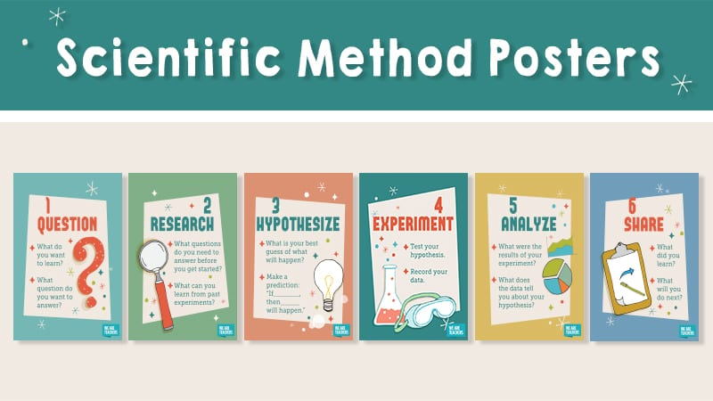
https://www.google.com/url?sa=i&url=https%3A%2F%2Fwww.weareteachers.com%2Ffree-scientific-method-posters%2F&psig=AOvVaw2oGo6vZuuuNCth8-_wzbf7&ust=1608474401088000&source=images&cd=vfe&ved=0CAMQjB1qFwoTCIjxh6Kg2u0CFQAAAAAdAAAAABAh

Slide 7
Research
The systematic investigation into and study of materials and sources in order to establish facts and reach new conclusions
Oxford English Dictionary

Slide 8
Why research?

Slide 9
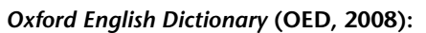
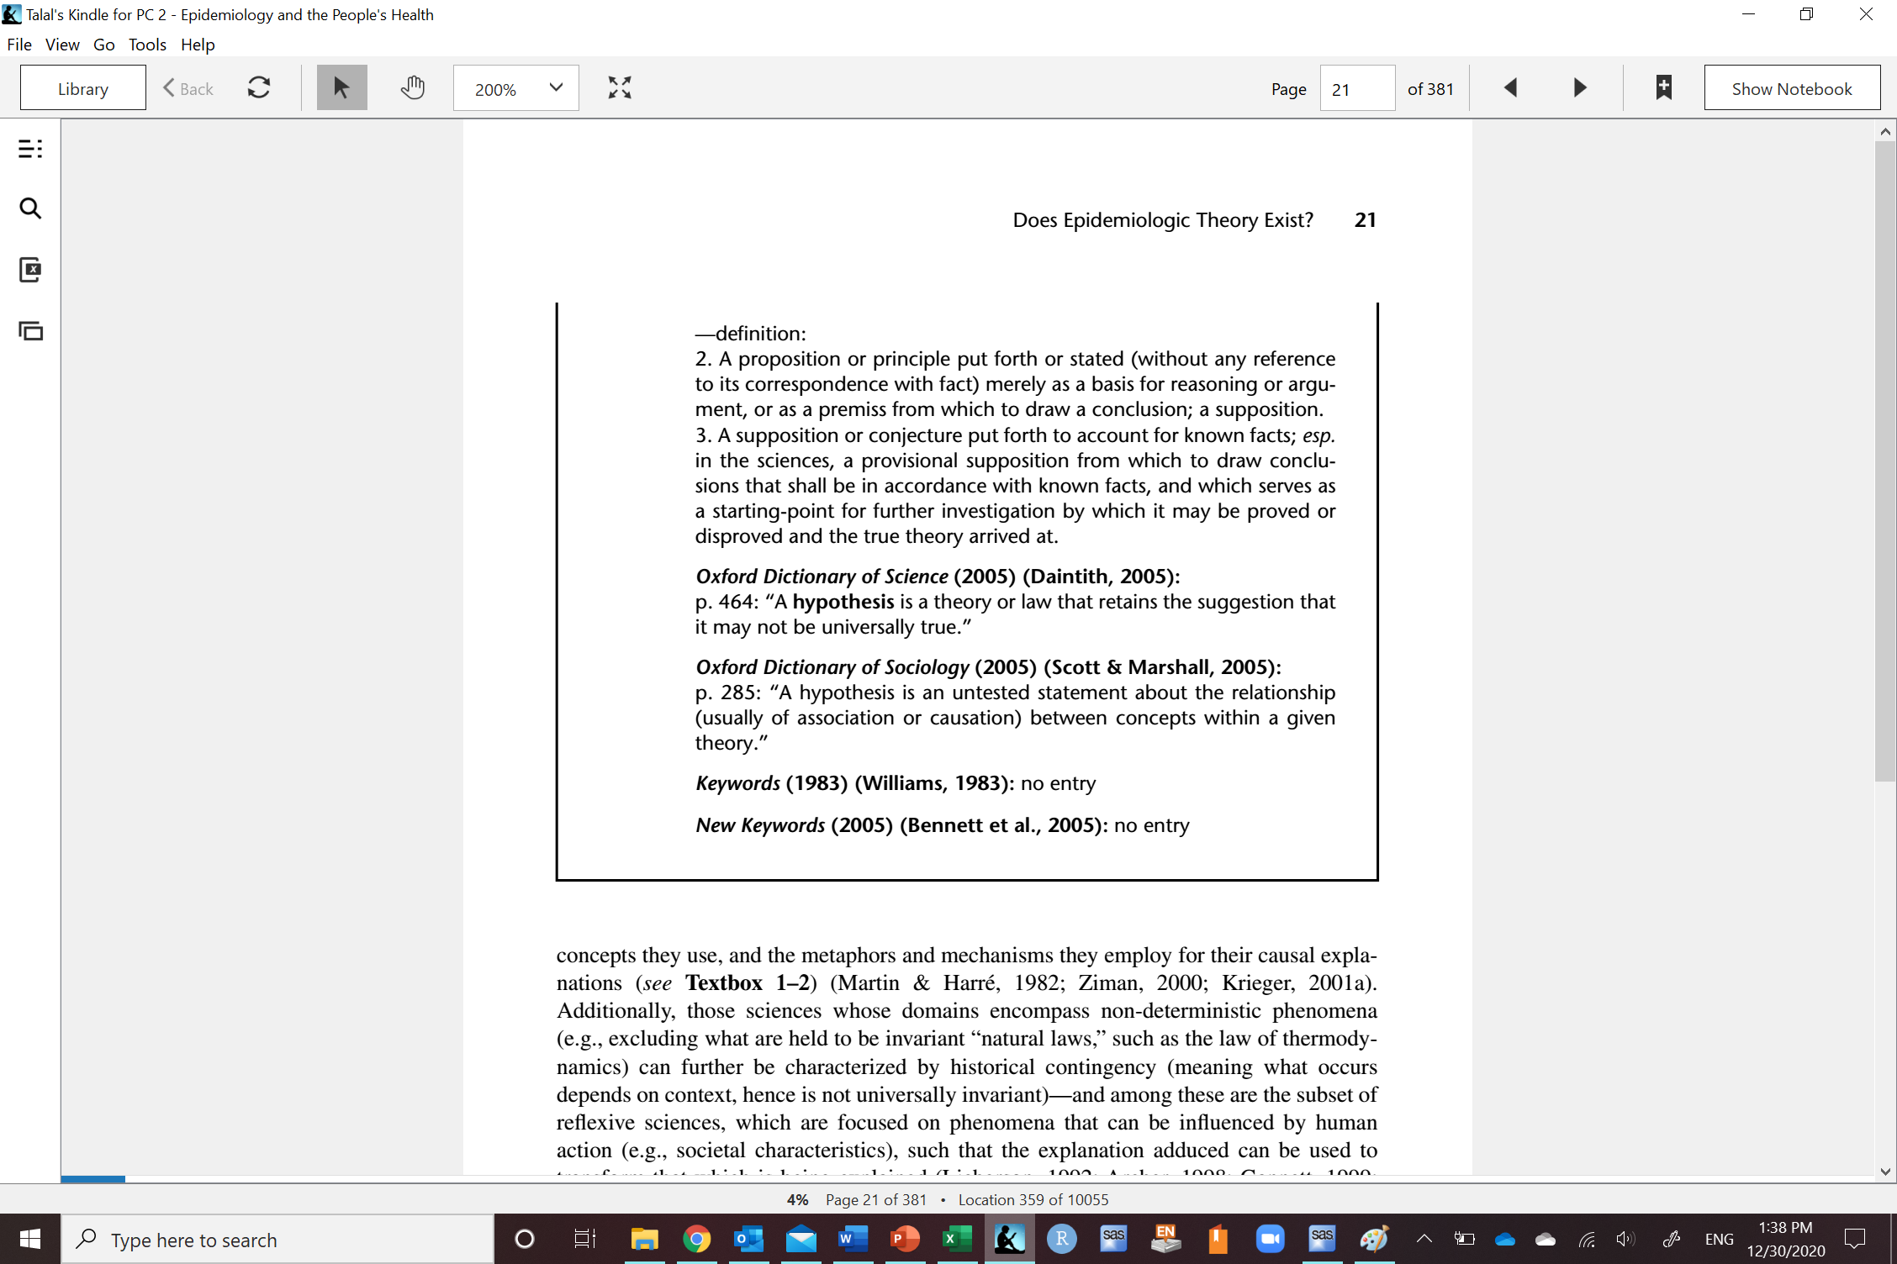
Hypothesis
Krieger N. Epidemiology and the people's health: theory and context. Oxford University Press; 2011 Mar 23.

Slide 10
Hypothesis
Null: average height difference between males and females is zero (some males are taller and some are shorter)
Sharp null: height difference between males and females is exactly zero for everybody (all males and females have the same height)
Other: average height difference between males and females is non-zero
average height difference between males and females is positive
average height difference between males and females is negative
average height difference between males and females is exactly 5 cm
average height difference between males and females is at least 5 cm
average height difference between males and females is at most -5 cm
average height difference between males and females is at least |5| cm
Krieger N. Epidemiology and the people's health: theory and context. Oxford University Press; 2011 Mar 23.

Slide 11
The nature of inference Example by Matt Fox
10, 20, 30
I have a rule/hypothesis connecting these number (assume it is the truth)
Give me three numbers and I will tell you whether the rule applies to them or not
Tell me the rule or hypothesis?

Slide 12
Potential rules or hypothesis connecting (10, 20, 30)
Multiply the first number by 1, 2, 3 (e.g., 1, 2, 3)
Add 10 (e.g., 40, 50, 60)
Add the same amount between the numbers (e.g., 4, 6, 8)
Ascending
Etc.

Slide 13
Potential rules or hypothesis connecting (10, 20, 30)
Multiply the first number by 1, 2, 3
1, 2, 3
100, 200, 300
3, 6 ,9
2, 4, 6
4, 8, 12
5, 10, 15
Etc.
1, 2, 5
The hypothesis I have in mind (i.e., truth) applies to these numbers
At what point do we accept this hypothesis?
One observation is enough to disprove/discredit a hypothesis

Slide 14
Potential rules or hypothesis connecting (10, 20, 30)
Add 10
40, 50, 60
20, 30, 40
100, 110, 120
55, 65, 75
31, 41, 51
77, 87, 97
Etc.
1, 2, 5
The hypothesis I have in mind (i.e., truth) applies to these numbers
At what point do we accept this hypothesis?
One observation is enough to disprove/discredit a hypothesis

Slide 15
Potential rules or hypothesis connecting (10, 20, 30)
Add the same amount between the numbers
4, 6, 8
20, 30, 40
3, 6 ,9
2, 4, 6
31, 41, 51
77, 87, 97
Etc.
1, 2, 5
The hypothesis I have in mind (i.e., truth) applies to these numbers
At what point do we accept this hypothesis?
One observation is enough to disprove/discredit a hypothesis

Slide 16
Potential rules or hypothesis connecting (10, 20, 30)
Ascending
4, 6, 8
20, 30, 40
3, 6 ,9
2, 4, 6
31, 41, 51
77, 87, 97
Etc.
1, 2, 5
The hypothesis I have in mind (i.e., truth) applies to these numbers
At what point do we accept this hypothesis?
Not disproved

Slide 17
Potential rules or hypothesis connecting (10, 20, 30)
Multiply the first number by 1, 2, 3 (e.g., 1, 2, 3)
Add 10 (e.g., 40, 50, 60)
Add the same amount between the numbers (e.g., 4, 6, 8)
Ascending
Etc.
Disproved by 1, 2, 5
Not disproved by 1, 2, 5

Slide 18
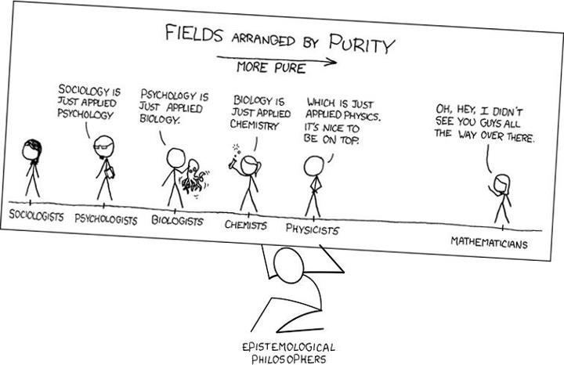
By Stephen Frezza https://www.researchgate.net/figure/Problems-in-Epistemology-Fields-arranged-by-purity-17_fig1_331592259

Slide 19
Conjecture and refutation
Deductive falsification

Slide 20
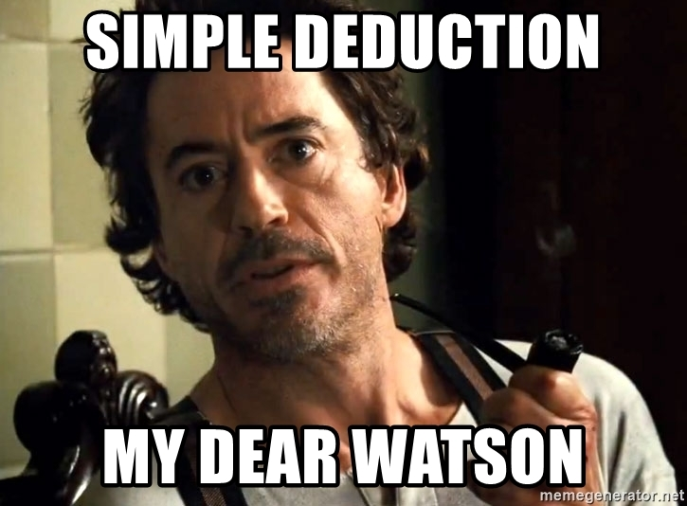
https://www.google.com/url?sa=i&url=https%3A%2F%2Fmemegenerator.net%2Finstance%2F62295396%2Fsherlock-holmes-robert-downey-jr-simple-deduction-my-dear-watson&psig=AOvVaw28-sfFD9ctW2RP-2rM1CSj&ust=1608384466999000&source=images&cd=vfe&ved=0CAMQjB1qFwoTCKidgZrR1-0CFQAAAAAdAAAAABAD

Slide 21
But what is deduction?

Slide 22
Propositional Logic

Slide 23
Proposition
I woke up early

Slide 24
Negation
A (I woke up early) | Not A (I did not wake up early)
T | F
F | T

Slide 25
Conjunction
A (I woke up early) | B (I ate breakfast) | A and B (I woke up early and ate breakfast)
T | T | T
T | F | F
F | T | F
F | F | F
A
A and B
B

Slide 26
Disjunction
A (I woke up early) | B (I ate breakfast) | A or B (I woke up early or ate breakfast)
T | T | T
T | F | T
F | T | T
F | F | F
A
A and B
B
A
B

Slide 27
Implication
A (I woke up early) | B (I ate breakfast) | A then B (I woke up early then ate breakfast)
T | T | T
T | F | F
F | T | T
F | F | T
If I wake up early and I eat breakfast then the implication is true
If I wake up early and I don’t eat breakfast then the implication is false
What If I don’t wake up early and I eat breakfast? Is the implication false? This does not invalidate that if I wake up early I will eat breakfast.
If I don’t wake up early and I don’t eat breakfast then the implication is also true

Slide 28
Implication and promises Example inspired by Bruce Ikenaga
A (If you graduate from dental school) | B (your father will buy you a car) | A then B (If you graduate from dental school then your father will buy you a car)
T | T | T
T | F | F
F | T | T
F | F | T
Did your father keep his promise?
If you graduate from dental school and your father buys you a car
Yes
If you graduate from dental school and your father doesn't buy you a car
No
If you don’t graduate from dental school and your father buys you a car
Yes
If you don’t graduate from dental school and your father doesn’t buy you a car
Yes
https://sites.millersville.edu/bikenaga/math-proof/truth-tables/truth-tables.html

Slide 29
Deductive arguments
Composed of premises and conclusion
Judge the conclusion based on evidence provided by the premises
Hypothesis
Data
Premise 1: If A then B
Premise 2: A
Conclusion: B

Slide 30
Valid deductive arguments
If the premises are true then and the conclusion is always true
Truth of premises necessitate truth of conclusion
Include
Affirming the antecedent (modus pollens)
Denying the consequent (modus tollens)

Slide 31
Valid deductive arguments Denying the consequent (modus tollens)
Premise 1: If A then B
Premise 2: Not B
Conclusion: Not A
A | B | Premise 1 (If A then B) | Premise 2 (Not B) | Both premises 1 and 2 | Conclusion (Not A)
T | T | T | F | F | F
T | F | F | T | F | F
F | T | T | F | F | T
F | F | T | T | T | T
When both premises are true
The conclusion is always true

Slide 32
Valid deductive argument Modus tollens
Hypothesis
Observation/data
Premise 1: If all swans are white, then we should not observe black swans
Premise 2: We observed black swans
Conclusion: Therefore, not all swans are white
A (All swans are white) | B (we should not observe black swans) | Premise 1 A then B (If all swans are white, then we should not observe black swans) | Premise 2 Not B (We observe black swans) | Both premises | Conclusion Not A (not all swans are white)
T | T | T | F | F | F
T | F | F | T | F | F
F | T | T | F | F | T
F | F | T | T | T | T

Slide 33
Valid deductive argument Modus tollens
Premise 1: If the farmer loves the sheep, then the sheep is not sacrificed in Al-Eid
Premise 2: The sheep sacrificed in Al-Eid
Conclusion: Therefore, the farmer does not love the sheep
A (the farmer loves the sheep) | B (the sheep is not sacrificed in Al-Eid) | Premise 1 A then B (If the farmer loves the sheep, then the sheep is not sacrificed in Al-Eid) | Premise 2 Not B (The sheep sacrificed in Al-Eid) | Both premises | Conclusion Not A (farmer does not love the sheep)
T | T | T | F | F | F
T | F | F | T | F | F
F | T | T | F | F | T
F | F | T | T | T | T

Slide 34
Hold on, we just did this with the numbers example right?
Modus tollens is the deductive falsification argument (the basis of science)

Slide 35
Invalid deductive arguments
If the premises are true and the conclusion is not always true
Truth of premises does necessitate truth of conclusion
Include
Affirming the consequent
Denying the antecedent

Slide 36
Invalid deductive arguments Affirming the consequent
Premise 1: If A then B
Premise 2: B
Conclusion: A
A | B | Premise 1 (If A then B) | Premise 2 (B) | Both premises 1 and 2 | Conclusion (A)
T | T | T | T | T | T
T | F | F | F | F | T
F | T | T | T | T | F
F | F | T | F | F | F
When both premises are true
The conclusion is not always true (can be false)

Slide 37
Invalid deductive argument Affirming the consequent
Premise 1: If all swans are white, then we should not observe black swans
Premise 2: We do not observe black swans
Conclusion: Therefore, all swans are white
A (All swans are white) | B (we should not observe black swans) | Premise 1 A then B (If all swans are white, then we should not observe black swans) | Premise 2 B (We do not observe black swans) | Both premises | Conclusion A (all swans are white)
T | T | T | T | T | T
T | F | F | F | F | T
F | T | T | T | T | F
F | F | T | F | F | F

Slide 38
Invalid deductive argument Affirming the consequent
Premise 1: If the farmer loves the sheep, then the sheep is not sacrificed in Al-Eid
Premise 2: The sheep is not sacrificed in Al-Eid
Conclusion: Therefore, the farmer loves the sheep
A (the farmer loves the sheep) | B (the sheep is not sacrificed in Al-Eid) | Premise 1 A then B (If the farmer loves the sheep, then the sheep is not sacrificed in Al-Eid) | Premise 2 B (The sheep sacrificed in Al-Eid) | Both premises | Conclusion A (farmer does not love the sheep)
T | T | T | T | T | T
T | F | F | F | F | T
F | T | T | T | T | F
F | F | T | F | F | F

Slide 39
Example using dental caries and sugars

Slide 40
Valid deductive argument
Hypothesis
Observation/data
Premise 1: If sugar does not cause caries, then we should observe that those who consume sugars have the same caries rate compared to those who do not
Premise 2: We did not observe the same caries rate among those who consumed sugars compared to those who do not
Conclusion: Therefore, the hypothesis that sugar does not cause caries is false
Modus tollens

Slide 41
Invalid deductive argument
Premise 1: If sugar does not cause caries, then we should observe that those who consume sugars have the same caries rate compared to those who do not
Premise 2: We observed the same caries rate among those who consumed sugars compared to those who do not
Conclusion: Therefore, the hypothesis that sugar does not cause caries is true
Logical fallacy: affirming the consequent

Slide 42
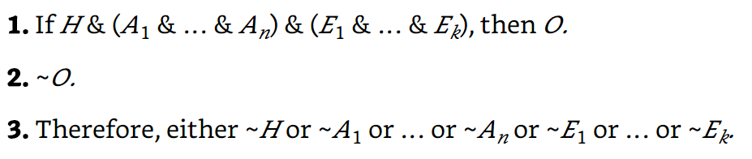
Deductive falsification argument
Auxiliary factors linking substantive and statistical claims
Hypothesis of interest
Assumptions of the statistical model
Observation/data
Modus tollens
Mayo DG. Statistical inference as severe testing. Cambridge: Cambridge University Press; 2018.

Slide 43
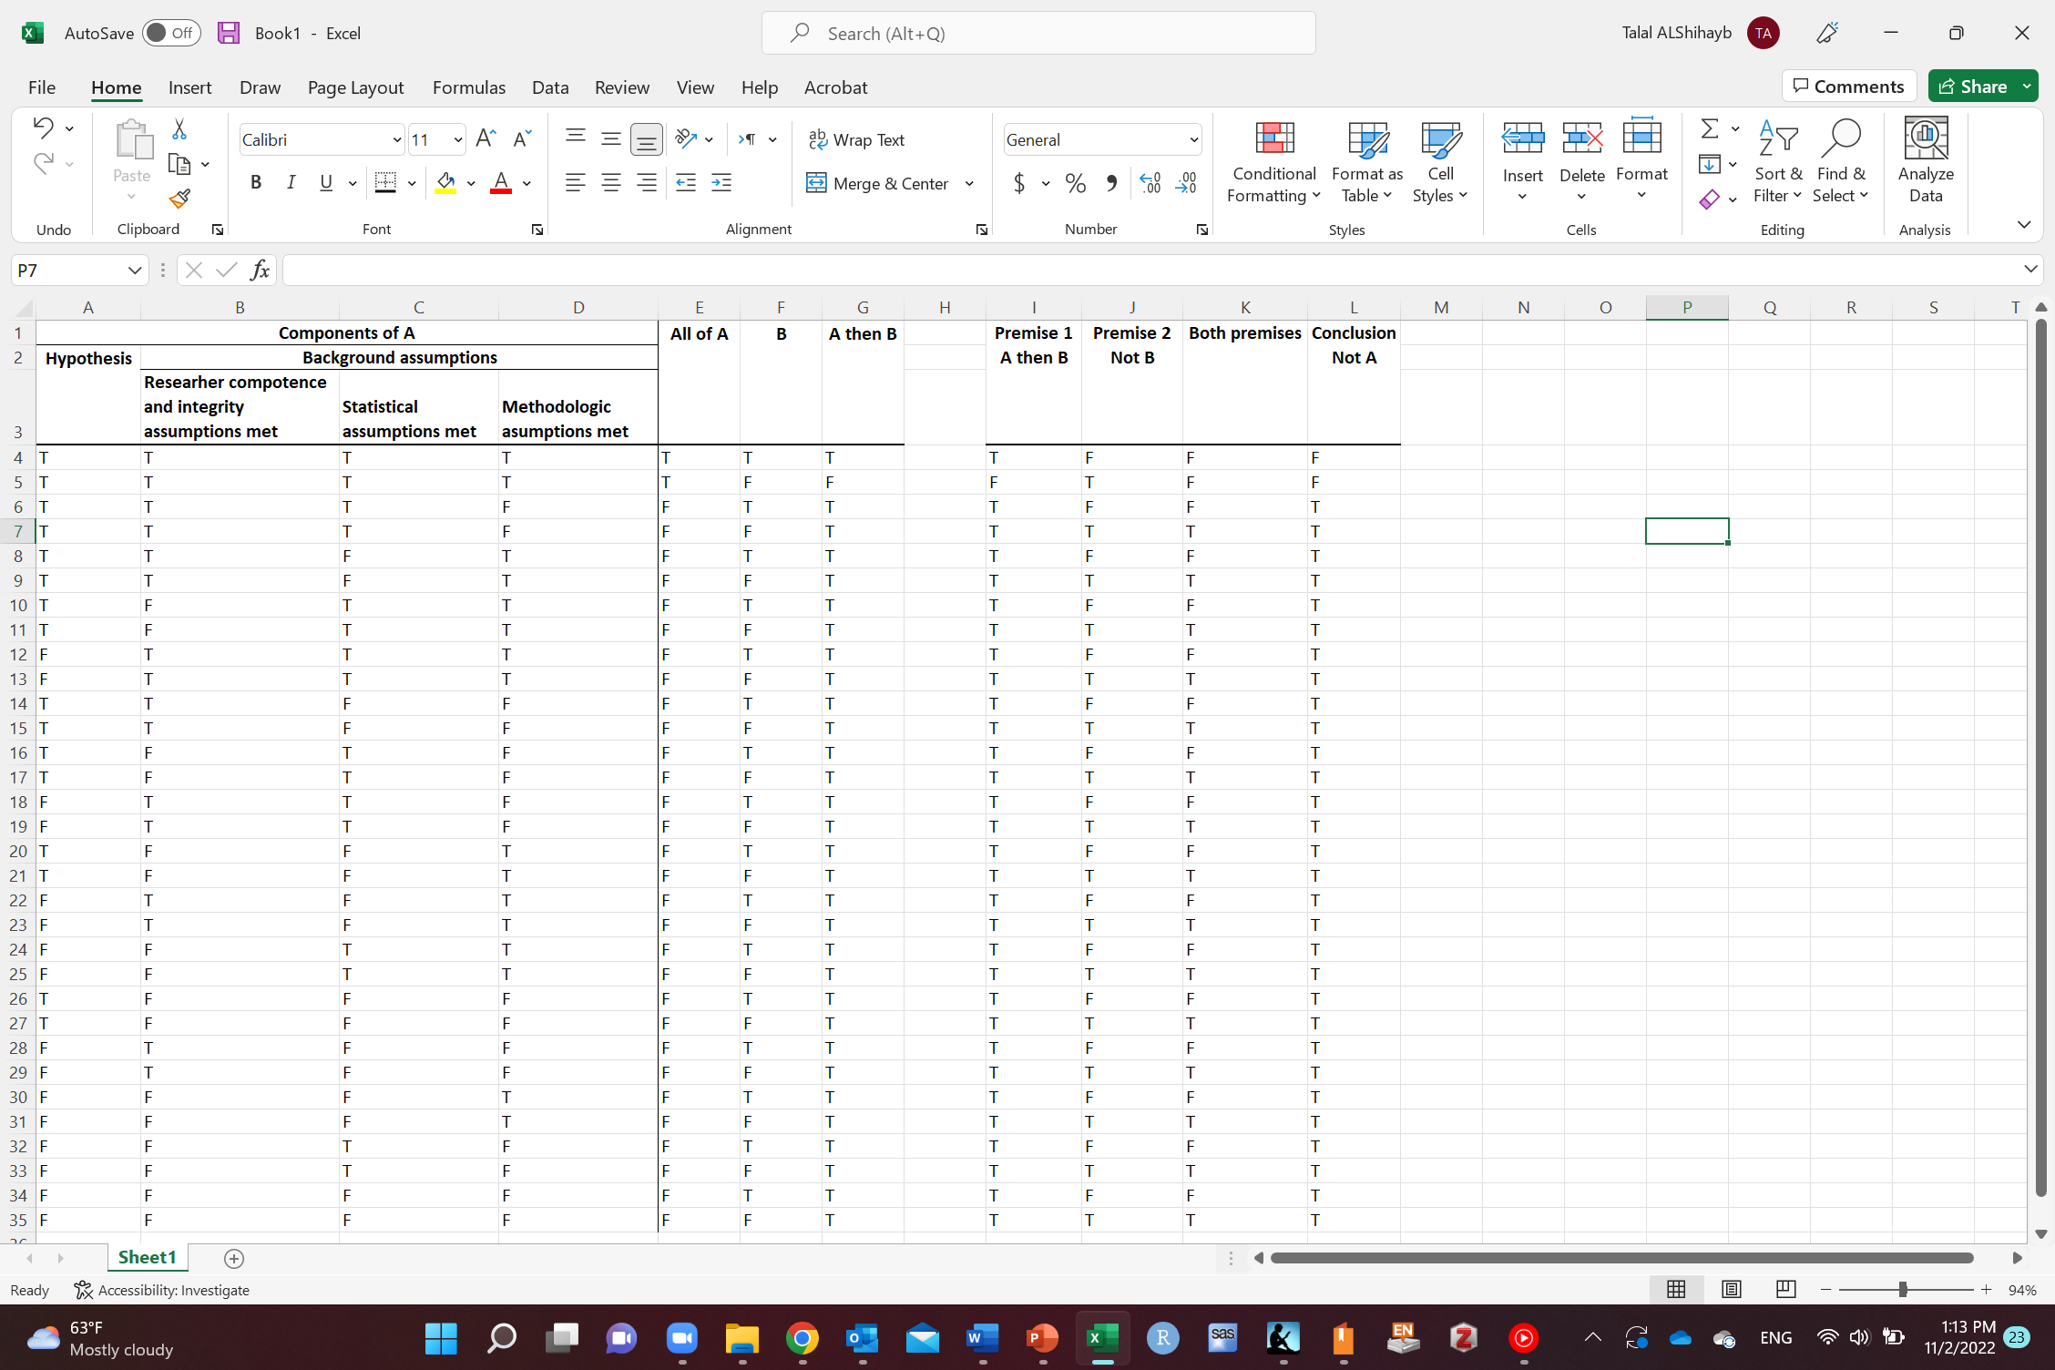
Deductive falsification argument for research
Truth table
Greenland S, Chow ZR. To aid statistical inference, emphasize unconditional descriptions of statistics. arXiv preprint arXiv:1909.08583. 2019 Sep 18.

Slide 44
Hypothesis
Null: average height difference between males and females is zero (some males are taller and some are shorter)
Other: average height difference between males and females is non-zero
average height difference between males and females is positive
average height difference between males and females is negative
average height difference between males and females is exactly 5 cm
average height difference between males and females is at least 5 cm
average height difference between males and females is at most -5 cm
average height difference between males and females is at least |5| cm
Krieger N. Epidemiology and the people's health: theory and context. Oxford University Press; 2011 Mar 23.

Slide 45
Our hypothesis of interest
Usually not interested in null hypothesis
Example
Sugar causes caries
This is our hypothesis of interest
We should falsify “Sugar causes caries”
We should not falsify the null hypothesis version “sugar does not cause caries” and then conclude that sugar causes caries

Slide 46
Drawbacks of the deductive falsification arguments
Sometimes our hypothesis of interest is not black or white
Easy to falsify all swans are white
How do you falsify 80% of swans are black?
Falsification is often based on consensus and not logic (does not follow the modus tollens argument)
Some think that science advances from funeral to a funeral
“A new scientific truth does not triumph by convincing its opponents and making them see the light, but rather because its opponents eventually die, and a new generation grows up that is familiar with it.”
Max Planck
McElreath R. Statistical rethinking: A Bayesian course with examples in R and Stan. CRC press; 2020 Mar 13.

Slide 47
Process of inquiry/research
Problem
Research question/hypothesis
Study population
Study design
Inclusion/exclusion criteria
Definitions
Data collection measurements
Analysis and modeling
Interpretation
Reporting and dissemination
Martha Werler, Bias, Society for Epidemiologic research 2020

Slide 48
Process of inquiry/research
Problem
Introduction and literature review section
Research question/hypothesis
Study population
Study design
Inclusion/exclusion criteria
Definitions
Methods section
Data collection measurements
Analysis and modeling
Results section
Interpretation
Discussion section
Reporting and dissemination

Slide 49
If we want to conduct a research, then we need a research question

Slide 50
What is a research question?
“A question that you have that you plan to answer, or at least try to answer by doing research”
Nick Huntington-Klein
The effect: An Introduction to Research Design and Causality by Nick Huntington-Klein https://theeffectbook.net/

Slide 51
A good research question
“Coming up with a research question is easy. Just ask any five-year-old and they can provide you with dozens. Coming up with a good research question is much harder”
A good question is:
Well-defined
Answerable
Potentially can be answered
Understandable
Nick Huntington-Klein
The effect: An Introduction to Research Design and Causality by Nick Huntington-Klein https://theeffectbook.net/

Slide 52
A good research question
Does the question improve our understanding of how the world works?
If answered, it should inform something beyond the question itself
It should inform theory in some way
A good research question takes us from theory to hypothesis
The effect: An Introduction to Research Design and Causality by Nick Huntington-Klein https://theeffectbook.net/

Slide 53
A good research question
“A good test for whether a research question informs theory is to imagine that you find an unexpected result, and then wonder whether it would make you change your understanding of the world”
Nick Huntington-Klein
The effect: An Introduction to Research Design and Causality by Nick Huntington-Klein https://theeffectbook.net/

Slide 54
Criteria for a good research question
F: Feasible
I: Interesting
N: Novel
E: Ethical
R: Relevant

Slide 55
Criteria for a good research question
Is it specific and well defined? Clear purpose/goal
Is it written in a language that is well understood?
Can it be answered?
Is it suited for an ideal vs realistic/pragmatic situation
Is it important? To whom?
Wrong question bias. Society for Epidemiologic Research, 2020

Slide 56
Why start with a question?
Why not start with data and finding patterns or making predictions (data mining)?
Short answer: it can give you a wrong result
The effect: An Introduction to Research Design and Causality by Nick Huntington-Klein https://theeffectbook.net/

Slide 57
How do you know if you have a good research question?
Once answered, improves understanding of the world
Need to think of further issues:
Consider potential results (what would you make of the results)
Consider feasibility (can you get the right data? logistics)
Consider Scale (time, money)
Consider design (reasonable research design)
Keep it simple (don’t bite more than you can chew)
The effect: An Introduction to Research Design and Causality by Nick Huntington-Klein https://theeffectbook.net/

Slide 58
Where do research questions come from?
Curiosity
Opportunity
Access to data (Do this after understanding the data but before doing the analysis, unless your goal is data mining/prediction)
On the spot
Literature search
Discussion with colleagues
From real life observations
Suggested by mentors
Others?
The effect: An Introduction to Research Design and Causality by Nick Huntington-Klein https://theeffectbook.net/

Slide 59
Framing the research question
Population
Intervention
Comparison groups
Outcome
Time frame
E.g., among Saudis aged 30 and older who are diagnosed with stage I oral squamous cell carcinoma, what is the difference in 5-year survival between those who receive radiotherapy and those who do not receive radiotherapy?
E.g., among Saudis aged 30 and older who are diagnosed with stage I oral squamous cell carcinoma, what is the effect of receiving radiotherapy on 5-year survival compared to not receiving radiotherapy?
Wrong question bias. Society for Epidemiologic Research, 2020

Slide 60
Research question/hypothesis/objectives
Research question: major question researcher wants to answer
Specification of study objectives and hypothesis are first step towards formulating an approach to answering the research question
Research hypothesis: statements of the answers the researcher expects to find and why (based on previous research or experience)
Study objectives: what researcher wants to do to try answering the research question
Aday LA, Cornelius LJ. Designing and conducting health surveys: a comprehensive guide. John Wiley & Sons; 2006 Apr 14.

Slide 61
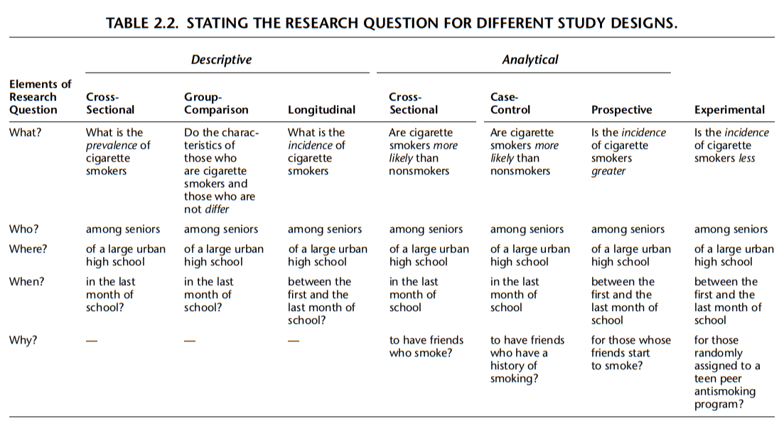
Aday LA, Cornelius LJ. Designing and conducting health surveys: a comprehensive guide. John Wiley & Sons; 2006 Apr 14.

Slide 62
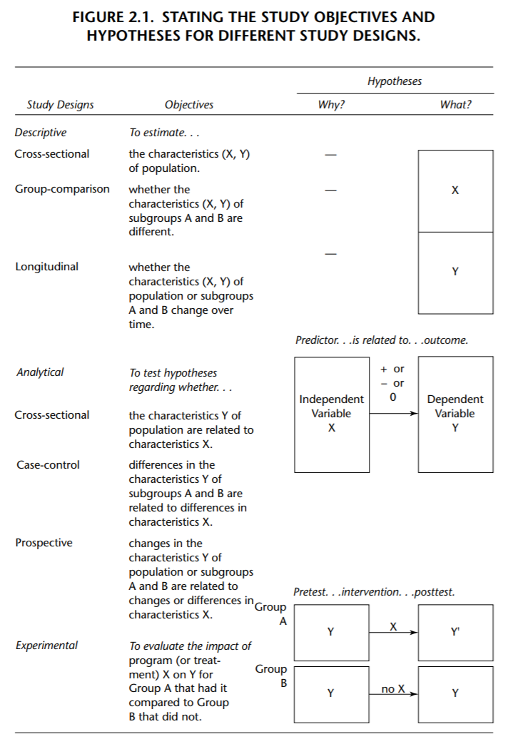
Aday LA, Cornelius LJ. Designing and conducting health surveys: a comprehensive guide. John Wiley & Sons; 2006 Apr 14.

Slide 63
Study objectives
In the form of to do
To describe
To predict
To estimate a causal effect
To estimate
To test
To compare
To evaluate
To assess
Etc.
Focus on one research question and its objective/objectives
Too many objectives is not encouraged (ambiguous)
Aday LA, Cornelius LJ. Designing and conducting health surveys: a comprehensive guide. John Wiley & Sons; 2006 Apr 14.

Slide 64
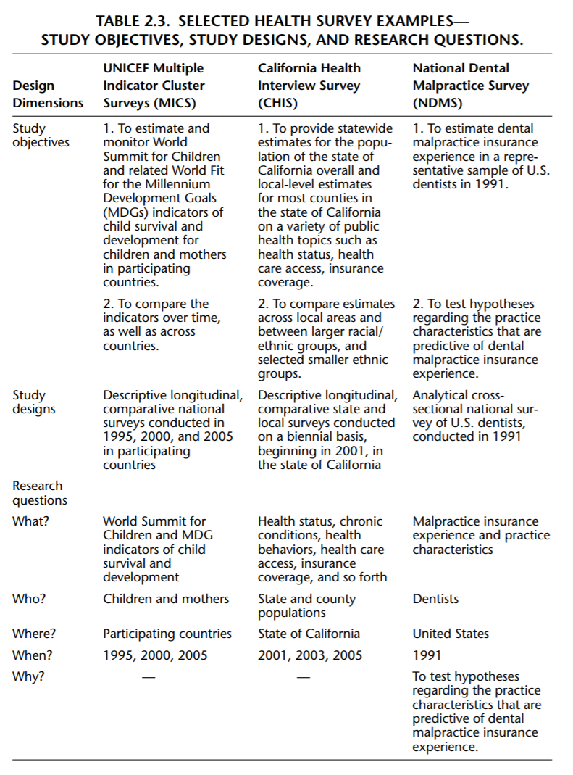
Aday LA, Cornelius LJ. Designing and conducting health surveys: a comprehensive guide. John Wiley & Sons; 2006 Apr 14.

Slide 65
Any Questions?
shihaybt@ksau-hs.edu.sa

